Slide 1
Formally Secure Compartmentalizing Compilation
Cătălin Hrițcu
Inria Paris
Notes:
I'm Catalin and I will tell you about formally secure compartmentalizing compilation. Don't worry, I'll explain what all these things are.

Slide 2



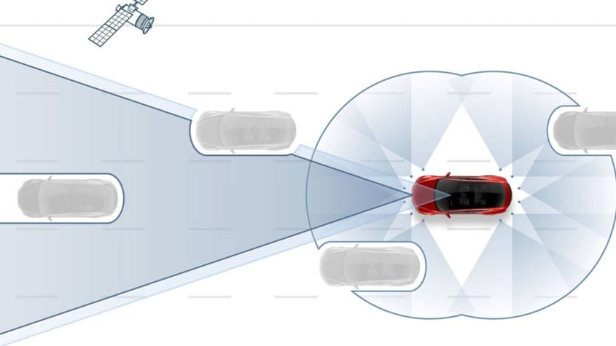

We are increasingly reliant on computers
... trusting them with our digital lives
Notes:
Our society is increasingly reliant on computers, and we are trusting these computers not only with our digital lives, but also with our physical lives.
Until a few years back, only planes used to have autopilots, but now in high-end cars have them too.

Slide 3
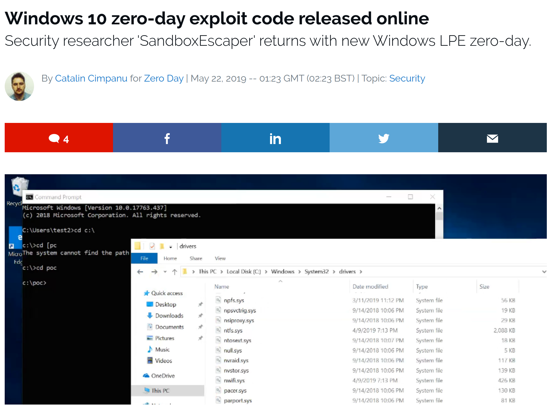
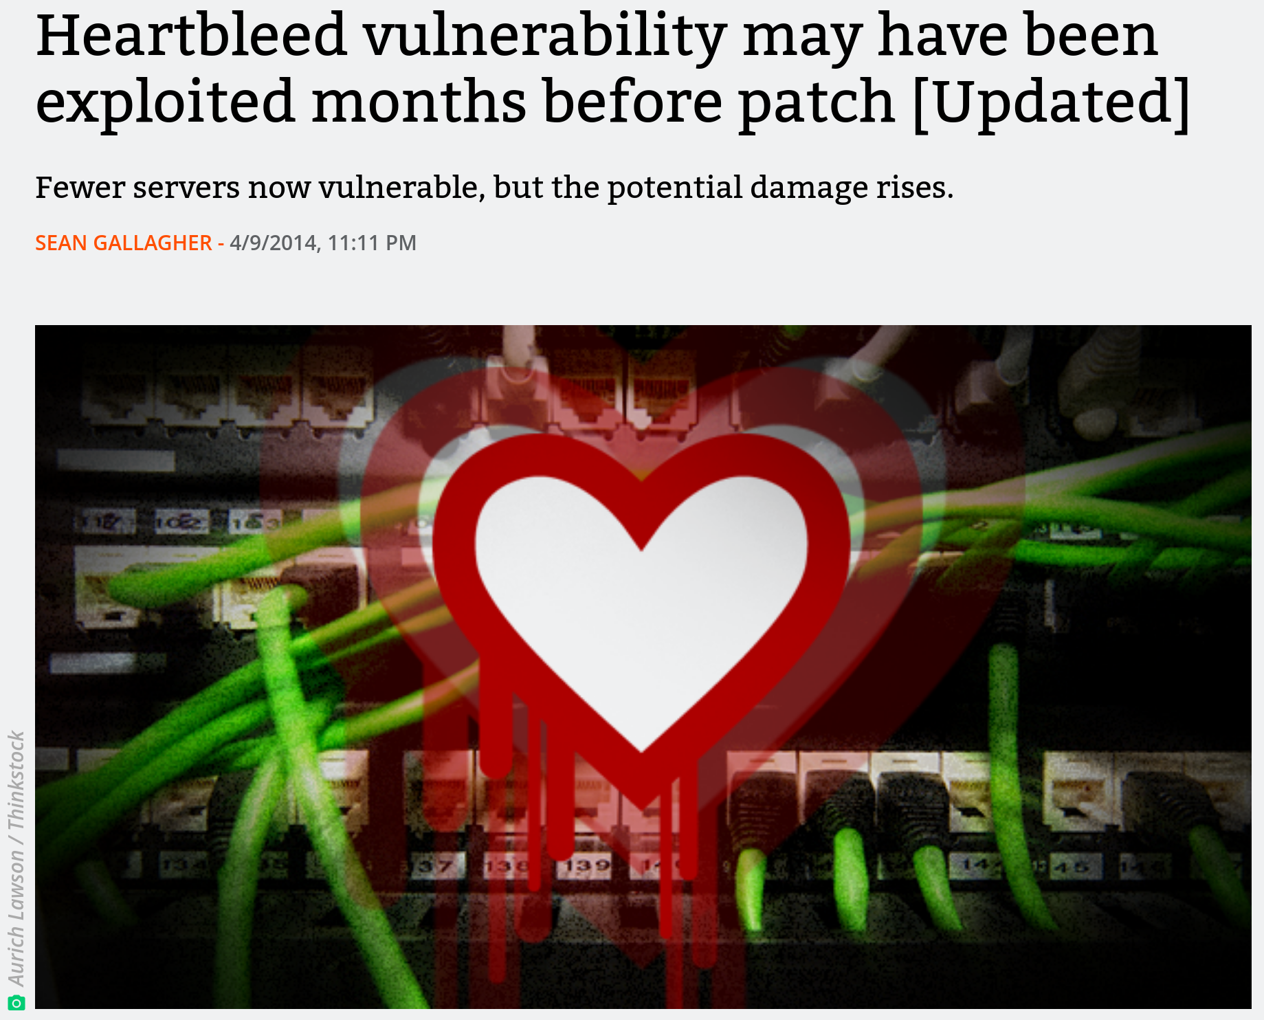


Computers vulnerable to hacking
Notes:
[Start]: Computers are, however, vulnerable to hacking.
[Precise explanation]: Hackers regularly exploit security vulnerabilities to take complete control of laptops, and servers, and phones, and even cars.
Researchers have demonstrated proof-of-concept attacks with they used to remotely turn off the breaks of a car going over 110 km/h.
[End]: We need to get out of this situation, and prevent from taking control of our computers.

Slide 4

Need to break the exploitation cycle
Once the stakes are high enough, attackers will find a way to exploit any vulnerability
Weak security defenses get deployed, but are routinely circumvented in practice
Security arms race
defenders find clever ways to "increase attacker effort"
attackers find clever ways around them
We need a deeper understanding that we can use to build provably secure defenses

Slide 5




Goal
Formal
Security
Proof
Enforcement
Notes:
I work on formal security, and for me formal security is about:
1. defining clear security goals
2. building effective security enforcement mechanisms targeted at these goals
3. and then tying the know by proving mathematically that the enforcement does achieve the security goals.

Slide 6

Web browsers are frequently hacked
Browser gets its input from the internet: a webpage (spiegel.de)
300+ resources loaded: html, image files, javascript, styles, ...
from 25+ different internet servers
4 are clearly for ads:
- ad.doubleclick.net
- ad.yieldlab.net
- amazon-adsystem.com
- adalliance.io
content, scripts, libraries, fonts, tracking, ...:
cdn3.optimizely.com, cloudfront.net, meetrics.net, dyn.emetriq.de, fonts.gstatic.com, googleapis.com, imagesrv.adition.com, js-agent.newrelic.com, omny.fm, mxcdn.net, de.com, script.ioam.de, parsely.com, criteo.net, emsservice.de, xplosion.de, googletagmanager.com, omnycontent.com, summerhamster.com

Slide 7

Malicious server can hack the browser
send it an image that looks like an ad
specially crafted to exploit a vulnerability in the browser's image drawing engine
this compromises the whole browser
i.e. gives server complete control over it
malicious server can now:
steal the user's data
take control of the victim's computer
encrypt victim's data and ask for ransom

Slide 8
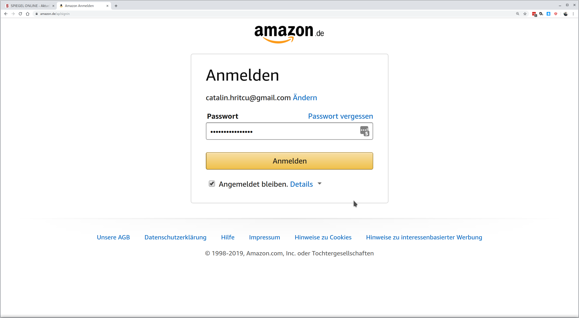

Compromised browser can steal user's data
I've just given my password to
the compromised browser
controlled by ad.doubleclick.net

Slide 9

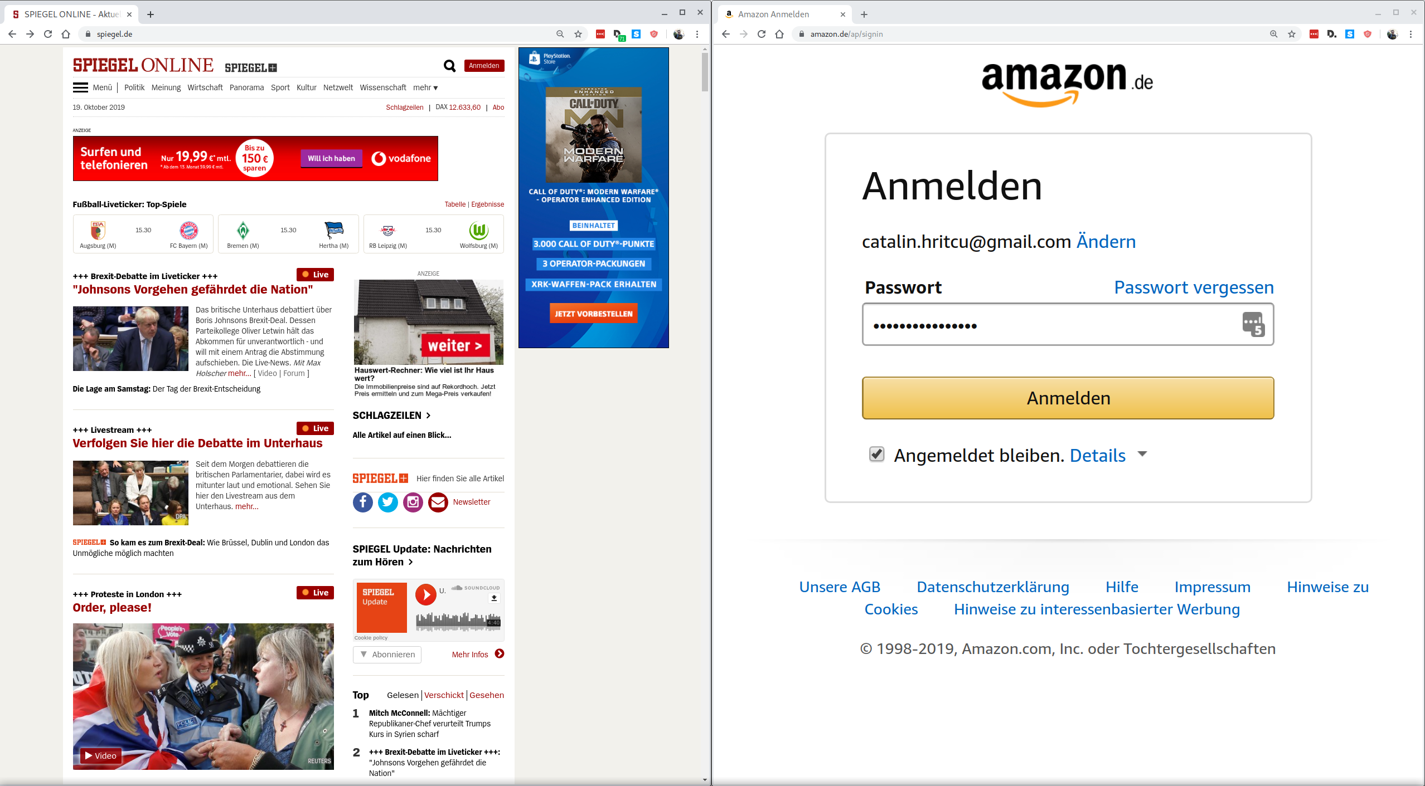
Compartmentalization can help
amazon.de password is still secure!
compromised
not compromised
compartment 1
compartment 2
Notes:
Explain better:
- the browser into separated into components, if one gets compromised the others don't get too much affected
- what happens within a component is as bad as before ... your spiegel pasowrd will be stolen

Slide 10
Good news: browsers now compartmentalized!
each tab indeed started in separate compartment
Bad news, so far:
limited compartmentalization mechanism
compartments coarse-grained
can compartmentalize tabs, but not secrets within a tab
compartments can't naturally interact
even for tabs this required big restructuring of web browsers
Notes:
TODO P2: some images

Slide 11

Fine-grained compartmentalization
spiegel.de
doubleclick.net
adalliance.io
spiegel.de

Slide 12


Fine-grained compartmentalization
spiegel.de
spiegel.de
facebook.com
spiegel.de
Spiegel.de password
is still protected

Slide 13


Source language compartments
Mozilla Firefox mostly implemented in C/C++
Programming languages like C/C++, Java, F*, ... already provide natural abstractions for fine-grained compartmentalization:
procedures, interfaces, classes, objects, modules, libraries, ...
a compartment can be a library/module/class or even an object (e.g., an image)
In the source language fine-grained compartments are easy to define and can naturally interact

Slide 14
Source language compartments
compartment C₁ {
private var x;
private procedure p() {
x := get_counter();
x := password;
}
}
compartment C₂ {
private var counter;
private var password;
public procedure get_counter() {
counter := counter + 1;
return counter;
}
}
←not allowed

Slide 15
Abstractions lost during compilation
Computers don't run C/C++, Java, or F*
Compiler translates Firefox from C/C++ to machine code instructions
All compartmentalization abstractions lost during compilation
no procedures, no interfaces, no classes, no objects, no modules, ...
Secure compilation
preserve abstractions through compilation, enforce them all the way down
Shared responsibility of the whole compilation chain:
source language, compiler, operating system, and hardware
Goal: secure compartmentalizing compilation chain
Notes:
TODO P2: add some picture

Slide 16
Machine-code level
Compartment C₁
<<check rx∈C₁>>
load r ← [rx]
put rc ← a_{password}
<<check rx∈C₁ or rx∈C₂'s interface>>
jump-and-link rx
sub r ← r-1
Compartment C₂
put rc ← a_{counter}
load r ← [rc]
add r ← r+1
store r → [rc]
jump ra
a_{counter} : 42
a_{password}: ...
←not allowed
compiled
get_counter
(public
procedure)
←not allowed
Securely enforcing source abstractions is challenging!
Notes:
TODO: maybe make code appear later? Or bring to the bottom? -- reduce back and forth between the data and code
At the machine-code level:
- the compiled code and data is stored in memory ... including the password
- should an instruction trying to load the password from memory be allowed?
- well, it depends on the which compartment does the load
- so we need to bring the compartment abstraction from the source to the machine-code level,
and split memory into compartments
- if the load of the password comes from another compartment it should not be allowed
...
Maybe: say that instructions are run in sequence
(Maybe one day: bring counter to top)

Slide 17
Formally Secure Compartmentalizing Compilation
Goal
Formal
Security
Proof
Enforcement
Notes:
I work on formal security, and for me formal security is about:
1. defining clear security goals
2. building effective security enforcement mechanisms targeted at these goals
3. and then tying the know by proving mathematically that the enforcement does achieve the security goals.

Slide 18
Formally Secure Compartmentalizing Compilation
Goal
Formal
Security
Proof
Enforcement

Slide 19

1. Security Goal
What does it mean for a compartmentalizing compilation chain to be secure?
formal definition expressing end-to-end security guarantees
these guarantees were not understood before
Will start with an easier definition
protecting a 1 trusted compartment from 1 untrusted one
untrusted compartment arbitrary (e.g. compromised Firefox)
trusted compartment has no vulnerabilities

Slide 20


This is not just hypothetical!
Mozilla shipping EverCrypt verified crypto library
(also used by Microsoft, Linux, ...)
Firefox
[POPL'16,'17,'18,'20, ICFP'17,'19, ESOP'19, CPP'18, SNAPL'17]
Formal verification milestone: 40.000+ lines of highly-efficient code, mathematically proved to be free of vulnerabilities (and functionally correct and side-channel resistant)
Notes:
End: and while I'm proud of this work, one needs to still put things in perspective.

Slide 21

Putting things into perspective
EverCrypt (verified in F*)
Firefox
40.000 lines
20.000.000 lines
+ external libraries
all unverified
Without compartmentalization interoperability is insecure: if Firefox is compromised it can break security of verified code
What does secure compartmentalization mean in this setting?

Slide 22


Preserving security against adversarial contexts
∀security property π
∀
F* context
EverCrypt
satisfies π
F*context
⇒
compiler
∀
machine code context
machine code
context
compiled
satisfies π
EverCrypt
protected
no extra power
Where "security property" can e.g., be safety or integrity or confidentiality [CSF'19]
π = "EverCrypt's private key is not leaked"
Notes:
TODO: explain safety property
W sat pi iff forall t, W ~> t => t in pi
- it would help to also introduce m, since it's used in a few slides

Slide 23


Extra challenges for our real security definition [CSF'16, CCS'18]
Program split into many mutually distrustful compartments
We don't know which compartments will be compromised
every compartment should be protected from all the others
We don't know when a compartment will be compromised
every compartment should receive protection until compromised
Compartment 1
Compartment 1
Compartment 2
Compartment 3
Compartment 4
Compartment 4
Compartment 5
Compartment 5

Slide 24
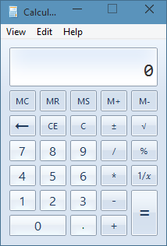
Formalizing security of mitigations is hard
We want source-level security reasoning principles
easier to reason about security in the source language if and application is compartmentalized
... even in the presence of undefined behavior
can't be expressed at all by source language semantics!
what does the following program do?
#include <string.h>
int main (int argc, char **argv) {
char c[12];
strcpy(c, argv[1]);
return 0;
}
Notes:
The main challenge with devising a formal definition for a mitifation, is that in order for such a definition to be useful, it should make it easier to reason about the security of ...

Slide 25
Compartmentalizing compilation should ...
Restrict spatial scope of undefined behavior
mutually-distrustful components
each component protected from all the others
Restrict temporal scope of undefined behavior
dynamic compromise
each component gets guarantees as long as it has not encountered undefined behavior
i.e. the mere existence of vulnerabilities doesn't necessarily make a component compromised

Slide 26
Security definition:
i₀
i₁
i₂
If
C₀
C₁
C₂
⇝_{machine} m
then
↓
↓
↓
∃ a sequence of component compromises explaining the finite trace m in the source language, for instance m=m₁·m₂·m₃ and
i₀
i₁
i₂
(1)
C₀
C₁
C₂
⇝_{source} m₁·Undef(C₁)
↯
i₀
i₁
i₂
(2)
∃A₁.
C₀
A₁
C₂
⇝_{source} m₁·m₂·Undef(C₂)
↯
i₀
i₁
i₂
(3)
∃A₂.
C₀
A₁
A₂
⇝_{source} m₁·m₂·m₃
Finite trace m records which component encountered
undefined behavior and allows us to rewind execution
Notes:
TODO: use the same visual clues as before
TODO: a lot of the explanations here happen in the air
- we say that a compartmentalizing compilation chain is secure, if whenever a program is compiled and then executed producing trace then there is a good explanation of this trace in the source language.
- the program we compile is composed in this example of 3 components: C0, C1, and C2
- the finite trace t records how the program as a whole interacts with the outside world (e.g. system calls)
- so we say that a compilation chain is secure when each trace t of the compiled program can be explained by some series of component compromises ("dynamic compromise scenario",)
TODO: Unsure the last takeaway is the best one for this slide - it seems a bit random

Slide 27



2. Security Enforcement
Prototype compartmentalizing compilation chain
compartment C₂ {
private var counter;
private var password;
public procedure get_counter() {
counter := counter + 1;
return counter;
}
}
Compartmentalized source language
Buffers, procedures, compartments
Compartmentalized intermediate language
Intermediate language with
built-in compartmentalization
Programmable tagged architecture
Bare-bone machine
Machine code
Hardware-accelerated enforcement
+Software enforcement
[POPL'14, Oakland'15, ASPLOS'15, POST'18, CCS'18]

Slide 28
Software-fault isolation
Compartment C₁
<<check rx∈C₁>>
load r ← [rx]
put rc ← a_{password}
<<check rx∈C₁ or rx∈C₂'s interface>>
jump-and-link rx
sub r ← r-1
Compartment C₂
a₁: put rc ← a_{counter}
a₂: load r ← [rc]
a₃: add r ← r+1
a₄: store r → [rc]
a₅: jump ra
a_{counter} : 42
a_{password}: ...
←not enough
Idea: rewrite C₁'s (& C₂'s) code to insert all the required checks
Challenges: checks complicated (uncircumventable, efficient)

Slide 29
Micro-Policies [POPL'14, Oakland'15, ASPLOS'15, POST'18, CCS'18]
software-defined, hardware-accelerated, tag-based monitoring
pc
tpc
tpc
mem[0]
tm0
r0
tr0
tr0
“store r0 r1”
tm1
tm1
r1
tr1
tr1
mem[2]
tm2
mem[3]
tm3
tm3
tm3
≠
tpc
tr0
tr1
=
tm3
tm3
tm1
store
monitor
allow
policy violation stopped!
(e.g. out of bounds write)
tpc’
tpc’
tm3’
tm3’
disallow
software monitor’s decision is hardware cached
Notes:
TODO: Switch to something more friendly to color blind people
SAY (start): They key enabler for this project is a software-hardware protection mechanism called micro-policies, on which I’ve been working in the past 4 years.
SAY (end): ... of course the software monitor can also disallow any instruction if it causes a violation of the enforce policy, for instance the monitor can disallow a write out of the bounds of an array if the color of the pointer doesn’t match the color of the memory location.
JPB: add enthusiasm, this is a really cool mechanism: efficient, fine-grained, expressive, adaptable, secure, formally verified, real – would need time to say it!

Slide 30
Compartmentalization micro-policy
Compartment C₁
load r ← [rx]
put rc ← a_{password}
jump-and-link rx
sub r ← r-1
Compartment C₂
a₁: put rc ← a_{counter}
a₂: load r ← [rc]
a₃: add r ← r+1
a₄: store r → [rc]
a₅: jump ra
a_{counter} : 42
a_{password}: ...
@EntryPoint
@NoEntry
not allowed
@NoEntry
@ ...
pc@C₂
pc@C₁
@NoEntry
Challenge: making sure returns go to the right place

Slide 31
Compartmentalization micro-policy (calls and returns)
invariant:
at most one
return capability
per call stack level
memory
registers
jump-and-link r
@n
pc
...
r
stack level
linear return capability
C₁
...
current color
@Ret n
@Ret n
cross-component call
only allowed at EntryPoint
...
changed color
...@EntryPoint
@(n+1)
pc
r_{a}
...
increment
store r_{a} → ⋆r_{m}
@(n+1)
pc
r_{a}
r_{m}
Enforcement
quickly gets
complicated
cross-component
return only allowed
via return capability
...
@(n+1)
pc
r_{a}
r_{m}
C₂
load ⋆r_{m} → r_{a}
jump r_{a}
@(n+1)
pc
r_{a}
r_{m}
loads and stores to the same
component always allowed

Slide 32

3. Security Proof
Proving mathematically that a compartmentalizing compilation chain achieves the security goal
formally verifying the security of the whole compilation chain
such proofs very difficult and tedious
wrong conjectures survived for decades; 250pg for toy compiler
we propose a more scalable proof technique
focus on machine-checked proofs in the Coq proof assistant
Proof-of-concept formally secure compilation chain in Coq

Slide 33


Verified
Compartmentalized unsafe source
Buffers, procedures, components
interacting via strictly enforced interfaces
generic proof technique
20K lines of Coq, mostly proofs
Compartmentalized abstract machine
Simple RISC abstract machine with
build-in compartmentalization
software fault isolation
Micro-policy machine
Bare-bone
machine
Tag-based reference monitor enforcing:
- component separation
- procedure call and return discipline
(linear capabilities / linear entry points)
Inline reference monitor enforcing:
- component separation
- procedure call and return discipline
(program rewriting, shadow call stack)
Systematically tested (with QuickChick)
https://secure-compilation.github.io

Slide 34
We reduce our proof goal to a variant of: Robust Safety Preservation
∀source components.
∀π safety property.
∀source components.
∀(bad/attack) finite trace m.
∀
source context
trace t
source context
source context
∃
.
source components
⇝t ⇒ t∈π
source context
source components
⇝m
.
⇔
⇒
⇒
compiler
compiler
back- translation
target context
target context
∀
target context trace t
compiled components
∃
compiled components
⇝t ⇒ t∈π
target context
⇝m
.
.
robust preservation of safety
proof-oriented characterization
Notes:
When compilation and back-translation are compositional, previous definition reduces to (a variant of) Robust Safety Preservation
Try to use the same terminology as before:
- programs -- sets of components
- context -- already compromised components
TODO: reduction only explained in the air

Slide 35

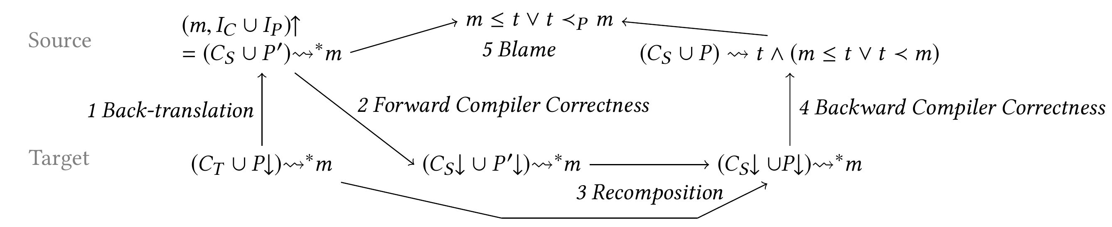
Scalable proof technique (for our variant of Robust Safety Preservation)
1. back-translating finite trace prefix to whole source program
2+4. compiler correctness proof (à la CompCert) used as a black-box
3+5. also simulation proofs, but at a single level

Slide 36


Summary
Compartmentalizing compilation is an important security defense in practice
1. Goal: formalize end-to-end security guarantees
first definition supporting mutually distrustful components and dynamic compromise
2. Enforcement: protect abstractions all the way down
software fault isolation or tag-based architecture
3. Proof: verify security of entire compilation chain
scalable proof technique machine-checked in Coq
Notes:
To sum up: compartmentalization is an important security defense in practice that allows us to limit the damage of exploitable vulnerabilities.
In this work we formalize the end-to-end security guarantees of fine-grained compartmentalization. We are the first to give a definition of secure compartmentalizing compilation that supports mutually distrustful components and dynamic compromise.
...

Slide 37
Making this more practical ... next steps:
Scale formally secure compilation chain to C language
allow pointer passing (capabilities for fine-grained memory sharing)
eventually support enough of C to measure and lower overhead
check whether hardware support (tagged architecture) is faster
Extend all this to dynamic component creation
rewind to when compromised component was created
... and dynamic privileges
capabilities, dynamic interfaces, history-based access control, ...
From robust safety to hypersafety (confidentiality) [CSF'19]
Secure compilation of EverCrypt, miTLS, ...
Notes:
TODO: add different trace models, mapping properties

Slide 38

My dream: secure compilation at scale
language
EverCrypt
C language
+ components
+ memory safety
memory safe C component
legacy C component
ASM language
(RISC-V + micro-policies)
ASM component
Notes:
SAY (beginning): The dream is to achieve secure compilation at scale at scale for realistic programming language

Slide 39
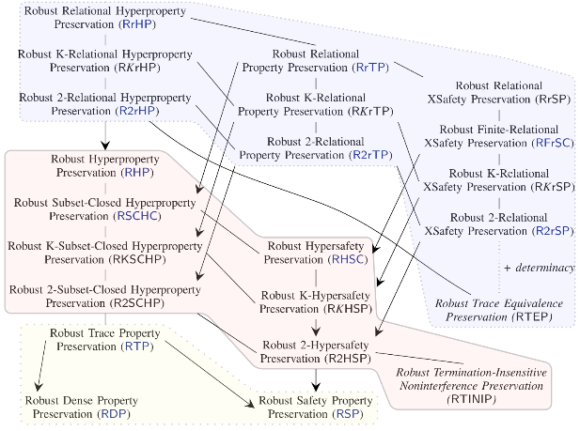






Going beyond Robust Preservation of Safety Journey Beyond Full Abstraction (CSF 2019)
Rob Blanco
Deepak
Garg
Jérémy Thibault
Carmine
Abate
Cătălin
Hrițcu
Marco
Patrignani
Inria Paris
MPI-SWS
Inria Paris
Inria Paris
Inria Paris
Stanford
& CISPA

Slide 40

Going beyond Robust Preservation of Safety [CSF'19]
No one-size-fits-all security criterion
relational
hyperproperties
(trace equivalence)
More secure
+ code confidentiality
current
proof
technique
realistically
enforceable?
hyperproperties
(noninterference)
+ data confidentiality
More efficient
to enforce
Easier to prove
trace properties
(safety & liveness)
only integrity

Slide 41
Summary
Compartmentalizing compilation is an important security defense in practice
1. Goal: formalize end-to-end security guarantees
first definition supporting mutually distrustful components and dynamic compromise
2. Enforcement: protect abstractions all the way down
software fault isolation or tag-based architecture
3. Proof: verify security of entire compilation chain
scalable proof technique machine-checked in Coq
Notes:
To sum up: compartmentalization is an important security defense in practice that allows us to limit the damage of exploitable vulnerabilities.
In this work we formalize the end-to-end security guarantees of fine-grained compartmentalization. We are the first to give a definition of secure compartmentalizing compilation that supports mutually distrustful components and dynamic compromise.
...

